Slide 1



Slide 2
Core Competencies
Promote exclusive breastfeeding without formula supplementation.
Explain the effect of formula supplementation on a mother’s milk production.
Provide realistic strategies to mothers on how to feed their baby only breastmilk and appropriate support and/or referrals as needed.

Slide 3
Learning Objectives
Explain how the breast makes milk.
Identify factors that affect milk production and the breastfeeding relationship.
Recognize how the food package supports exclusive breastfeeding.

Slide 4
Exclusive Breastfeeding
Definition: “An infant receiving only breast milk and no other liquids or solids except for drops or syrups consisting of vitamins, minerals, or medications” (Centers for Disease Control)
Exclusive breastfeeding has the strongest effect on infant and maternal health outcomes.

Slide 5

Exclusive Breastfeeding Objectives

Slide 6
When Mothers Start Feeding Infant Formula
52% of babies are being supplemented with infant formula in the hospital
61% of new mothers regularly give formula by 3 months
Half of new mothers have already started solid foods by 4 months
Half of WIC breastfed infants are fed formula during the first two weeks

Slide 7
Hospital Practices that Affect Exclusive Breastfeeding
Infant formula samples and discharge bags
Unnecessary formula supplementation
Pacifier use
Insufficient breastfeeding support

Slide 8
Why Mothers Offer Formula
Lack of confidence in their milk production
Lack of awareness of newborn behaviors
Concern that they cannot see how much the baby takes
Received formula from the hospital
Only able to express a small amount of breastmilk
True physical issues that affect production

Slide 9

Cultural Factors
Beliefs about colostrum
Wanting to fit in with the social norm
Participant-focused discussion makes a difference
Use culturally appropriate materials
West Dade, FL WIC

Slide 10

What WIC Staff Can Do
Use open-ended questions to explore concerns
Praise the mother
Teach basic breastfeeding technique during pregnancy
Yield
Unity Health Care WIC Washington, D.C.

Slide 11

How the Breast Makes Milk: Keep it Simple
A good foundation helps build long-term production
Breastfeed frequently (8-12 times every 24 hours)
Avoid infant formula supplements in early days
Photo courtesy of Liz Brooks, IBCLC

Slide 12
A Closer Look at How the Breast Makes Milk
Mammary gland – “mamma”
Mammary gland has many different parts, each with specific functions that help the mother produce milk for her baby

Slide 13
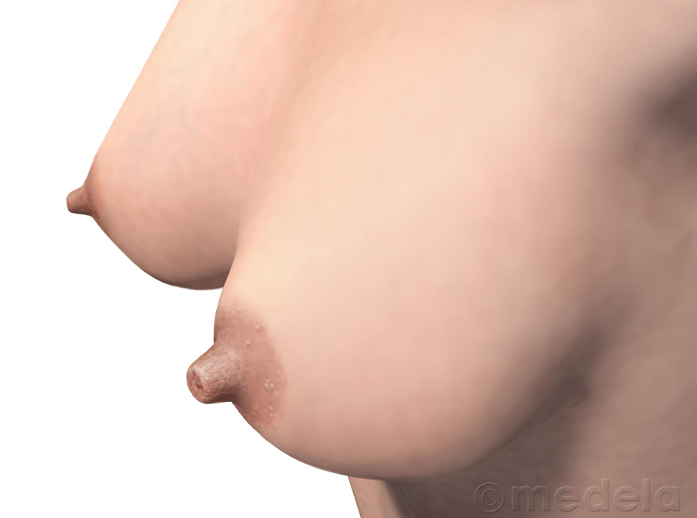

Stage 1: Getting Ready for Milk Production
Source: ©2009 Medela

Slide 14
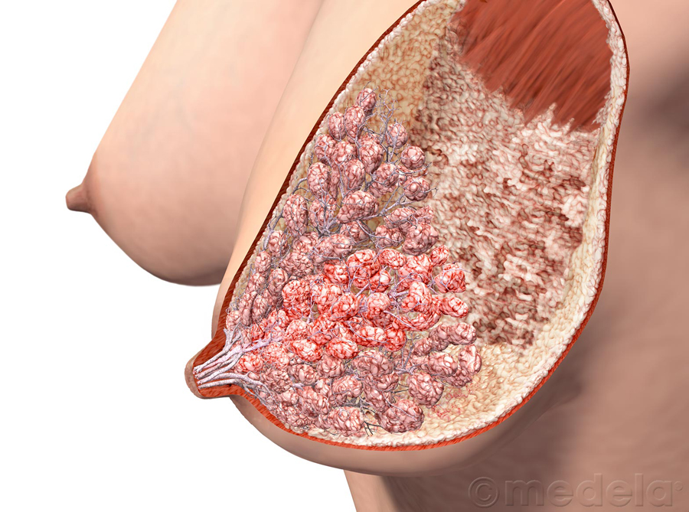
Inside the Breast – Milk-Making Tissue
Milk-making cells (alveoli) develop during pregnancy
Alveoli bunch into 7-10 clusters or lobes
Muscles (myoepithelial cells) tighten to release milk
Source: ©2009 Medela

Slide 15
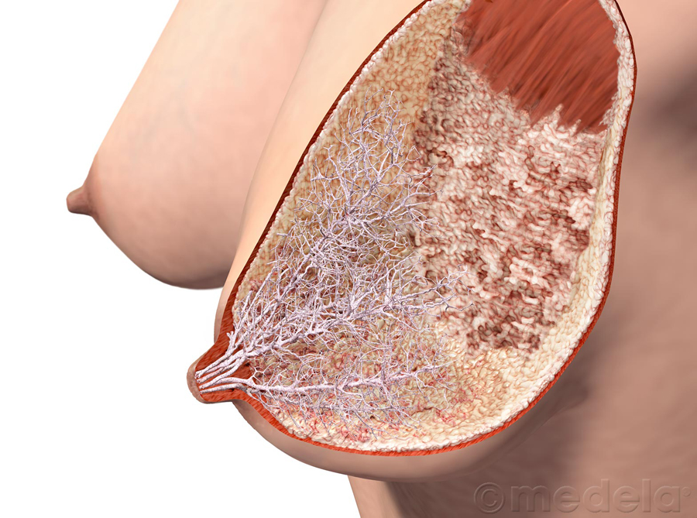
Inside the Breast The Milk Highway System
Source: ©2009 Medela

Slide 16
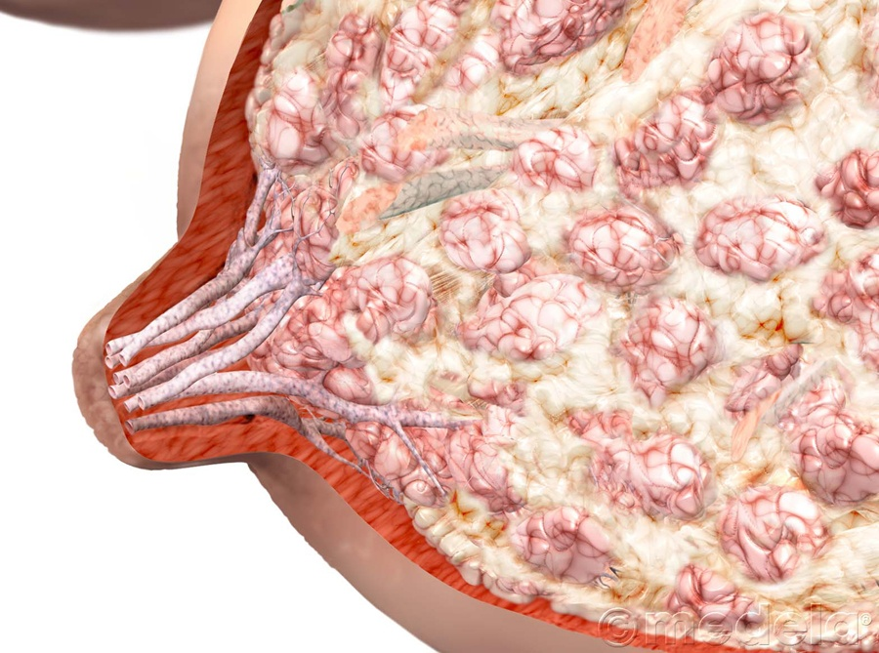
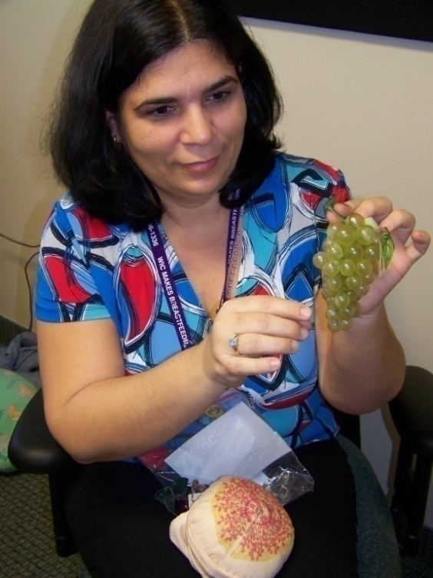
Inside the Breast Other Parts of the Breast
Miami-Dade WIC Program
Source: ©2009 Medela

Slide 17
Storage Capacity
Exclusively breastfeeding mothers make around 800 ml (22-24 oz) of milk per day months 1-6
Storage capacity is not determined by the size of the breast and can vary from mother to mother and breast to breast
A mother with a small storage capacity may need to feed her baby more often
Breastfeed 8-12 times/day
Watch for baby’s signs of hunger

Slide 18
Stage 2: Milk Production Begins
Pregnancy:
Milk-making tissue develops
Colostrum available around 16-18 weeks
Based on hormonal response
After baby is born: Lactogenesis II
Prolactin surge 30-72 hours
Milk volume increases
Oxytocin helps milk to flow

Slide 19
Risk Factors that Delay
Cesarean delivery
Hypothyroidism
Obesity (lowers prolactin response to suckling)
Type 1 Diabetes (insulin needed to make milk)
Mothers in their 40’s
Retained placental fragments

Slide 20

Oxytocin: The Mothering Hormone
Stimulated by:
Nipple stimulation
Sights, smells, and sounds of her baby
Touch
Inhibited by:
Stress
Fear
Pain

Slide 21
The Role of Hormone Receptors
Receptors for both prolactin and oxytocin built in first 2 weeks postpartum
Created in response to # of breastfeeds and amount of milk removed
Formula supplementation interferes with the process

Slide 22
Stage 3 – Maintaining Lactation The Important 1st Month

Slide 23

Seasons of the Breast

Slide 24

WIC Food Packages that Support Exclusive Breastfeeding
Breastfeeding food package designed to help mothers exclusively breastfeed to establish a good milk production
WIC food packages provide:
For infants: Priceless breastmilk of mother
For mothers: extra foods and support from WIC to continue breastfeeding exclusively

Slide 25
Case Study: North County Health Services, California WIC
No formula routinely issued in 1st month
Prenatal education and proactive, targeted contacts just before delivery or early postpartum
Increased rates of exclusive breastfeeding at 1 and 2 months
25% still breastfeeding at 10 months compared to 6.5% in control group

Slide 26
Lessons Learned from North County Health Services Policy Changes
Provide anticipatory guidance during pregnancy and critical weaning points
Train staff in assessment and counseling
Conduct targeted contacts and referrals
Support from all staff makes the difference

Slide 27

Talking With Mothers About WIC Food Packages
Begin the discussion during mom’s pregnancy
Breastfeeding exclusively builds milk production and increases feeding options
Every bottle of formula is that much less breastmilk mom’s body makes
Miami-Dade WIC

Slide 28
Using 3-Step to Encourage Mothers to Exclusively Breastfeed
Open-ended questions
What are people telling you about your milk production?
What goals do you have for breastfeeding?
Affirmation
Many mothers worry about making milk.
What a great mom you are for breastfeeding!

Slide 29
Education
Every bottle of formula given to the baby is that much less milk removed from the breast
Offering supplements decreases milk production
Offering bottles can create nipple confusion

Slide 30

SHOW ME!
DVD: “Show Me Video Vignettes”
Handout 5.1: “Show Me Video Vignettes: Counseling About Milk Production”

Slide 31

Practice: Moving Mothers from Worries to Confidence
Handout 5.2: “Moving Mothers from Worries to Confidence”

Slide 32
Anticipatory Guidance
Breast changes occur throughout pregnancy and lactation
Hold infant skin-to-skin in first hour
Continue breastfeeding at least 8-12 times every 24 hours
Follow the baby’s signs he is ready to eat
Position/latch infant to assure milk transfer
Avoid formula supplements
Watch for growth spurts
See baby’s doctor within 3-5 days after birth

Slide 33
Application To Practice
Handout 5.3 : “Application To Practice: Counseling About Milk Production”

Slide 34
Summary
Importance of exclusive breastfeeding
How the breast makes milk
Exclusive breastfeeding helps mothers establish and maintain production
Each WIC staff member plays a role in encouraging mothers to exclusively breastfeed

Slide 35

Grow Your Breastfeeding Skills
“My Goals for Breastfeeding Support”
Goal Setting-Flower

